Slide 1

MICROSPHERE
Microsphere is a Bluetooth synth controller, designed to familiarize with diatonic harmony.
COMPUTER MUSIC PROJECT
AA 2018 – 2019
BRUNDO NICOLETTA
GINO JACOPO
INTAGLIATA EMANUELE

Slide 2
INDEX
Concept
How MicroSphere works:
Environment
Algorithm
Audio synthesis
Interface & How to use it

Slide 3
CONCEPT

Slide 4
INTRODUCTION
A fundamental need for a musician is to learn how to express himself and how to transmit to an audience what he’s feeling.
There are several key skills to achieve and MicroSphere works on one of them:
GET USED TO HOW NOTES (AND SCALES) SOUND ON DIFFERENT CHORDS.

Slide 5
BASED ON SCALE BRIGHTNESS…
Literature tells that, in major harmony, a characteristic forthw perceived mood of the scales can be defined: brightness.
Scales can be ordered, from darkest to brightest as:
Locrian
Phryigian
Aeolian
Dorian
Myxolydian
Ionian
Lydian
The order is based on lowering intervals too.
Due to Micro:bit’s accuracy limitations, the user can play only 2 of the possible scales.
The algorithm gives to the user the two darkest modes, matching the seventh chord that is being played.
The idea is to facilitate exploration of the less used scales of major harmony.

Slide 6
…AND ON SEVENTH CHORDS SPECIES
Major third, perfect fifth, minor seventh: it calls for a mixolydian scale built on first grade. Locrian on 3° grade and Phrygian on the 6° are preferred;
Minor third, perfect fifth, minor seventh: min7th chord have lots of compatible scales, so that, phrygian and aeolian built on the first grade are returned;
Minor third, diminished fifth, minor seventh: locrian scale is the characteristic one of this chord, phrygian on the 4° grade is the other one chosen;
Major third, perfect fifth, major seventh: lydian and ionian scales are typical, following the principle of the application, 3° grade phrygian and 7° locrian are returned.

Slide 7
TABLE OF CHORDS AND MATCHING SCALES
GRADE CHORD | First Sharpened | Second Sharpened | Third Sharpened | Fourth Sharpened | Fifth Sharpened | Sixth Sharpened | Seventh Sharpened
X7 | Mixolydian | Aeolian | Locrian | Ionian | Dorian | Phrygian Lydian
Xmin7 | Dor, Phr, Aeol Lydian | Locr, Phry Ionian, Lydian |  | Mix, Dor, Aeol | Locr, Phr, Aeol Ionian, Lydian | Locrian Ion, Dor, Mix
Xmin7/b5 | Locrian Ionian | -- Dorian |  | Phrygian Lydian | -- Mixolydian | -- Aeolian
Xmaj7 | Ionian, Lydian | Mix, Dor | Phry, Aeol | Lydian Locrian | Mixolydian | Dor, Aeol | Locrian

Slide 8
HOW DOES IT WORK

Slide 9
ENVIRONMENT
MicroSphere is a web application.
Languages used for coding are: javascript, css and html.
Google Chrome is needed to launch the program. Google’s browser is the only one supporting experimental browser features, needed for BLE connection.
Firmware in Microbit is the Lancaster University one, developers of the microprocessor.

Slide 10
CODE DIVISION
BLE connection routine;
PROCEDURE II: chord acquirement and elaboration;
Returned scales are associated to Micro:bit’s accelerometer values;
Accelerometer values that are mapped on 3 axis: z>0 is necessary for the synth to be triggered, tilting is associated to notes, pitching is associated to scale changes;
Mapped accelerometer values trigger WAPI synthetiser;
Interface reacts on synth and scales behaviour.

Slide 11
BLE CONNECTION ROUTINE
Based on client (MB) / server (PC) model, where the PC asks for Micro:bit data.
Bluetooth Low Energy antenna is implemented in Micro:bit.
The firmware activates the needed antenna services on start of the microprocessor.
The code generates a window to trigger the search for available BLE devices.
No pairing is required by firmware: connection is already established.

Slide 12
PROCEDURE II
A seventh chord is played on the MIDI keyboard.
MIDI notes are scanned.
The lowest is assumed as the root.
The seven modes are generated starting from the root note.
Matches between the scales and the chord notes are found.
The two darkest scales, restricted to only two octaves, are returned.

Slide 13
WAPI SYNTHETISER
BLOCK DIAGRAM

Slide 14
Gain Modulator
Delay
Gain Delay
Connect (Osc. Freq)
Gain = FilterGain * 24
Oscillator
Modulator
Oscillator
Mod. Filter Gain
Distortion
Convolver
Rev. Wet Gain
Connect (Filter Detune)
- Freq.
- Type
- Freq.
- Type
Oscillator Gain
Filter
Envelope
(Gain)
Effect Chain??
Rev. Dry Gain
Master Gain
Effect Chain
- Type
- Oscillator value
- Frequency
- Detune
- Current Env. Decay
- Current Env. Sustain
- Current Env.
- Env
Compressor
Context Destination
Analyzer

Slide 15
INTERFACE
Wide screen: where melodic contour is visualized. Head of trace dimension varies on wrist posItion, associated with scale brightness. Head of trace position depends on note’s keyboard position. Trace depends on selected scale.
MIDI IN led: LED ON if MIDI notes are received from keyboard.
«Search device» button: BLE connection routine begins.
«Fullscreen» button: visualization page goes full screen.
«Start» button: melodic contour visualization begins.
«Reset» button: melodic contour visualization resets.
A two octaves keyboard displays which notes are played.

Slide 16
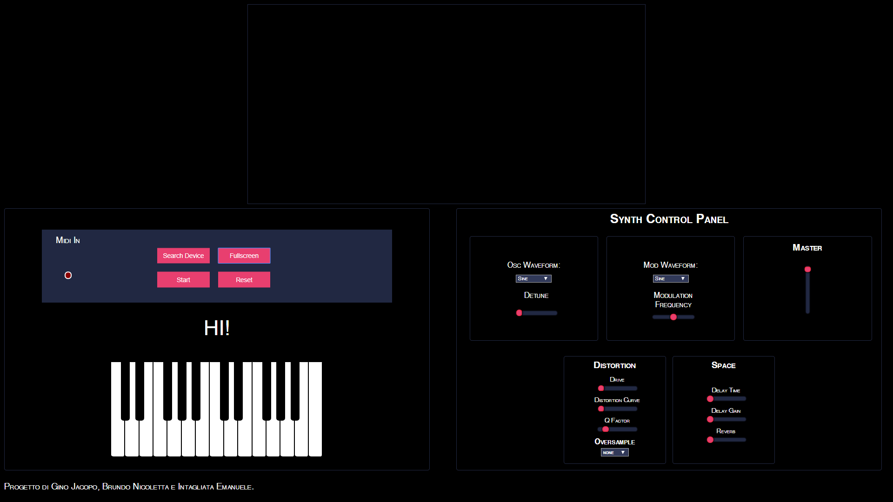

Slide 17
CONTROL PANEL
Oscillator section
Modulation section
Master Volume
FX section:
Distortion controls: drive, dist curve, q factor, oversample.
Space controls: delay time, delay gain, reverb.

Slide 18
AND NOW,
LET’S PLAY THE MICROSPHERE!

